Slide 1

CENG463 - Machine Learning
Predicting and Classifying Terrorism Incidents using Machine Learning
Presented by Faruk Kaplan, Ali Emre Pamuk, Mert Altekin

Slide 2
Table of Content
CENG463 - Machine Learning
Problem Definition
Trends and Patterns
Data Collection and Exploration
Future Predictions
Data Preprocessing
Improvements
Algorithms
Conclusion
Motivation
Experimental Scheme
Results

Slide 3

CENG463 - Machine Learning
Unpredictability and Complexity: Terrorism poses challenges in predicting attack success and identifying activity patterns.
Data Processing Limitations: Traditional methods struggle with analyzing large datasets on location, weapon types, and target demographics, resulting in inefficient resource use and delays.
Proactive Response Deficit: Governments and agencies face difficulties in implementing preventive counterterrorism measures, often reacting instead of preventing attacks.
Problem Definiton

Slide 4


Consequences and Emerging Threats: Increased casualties, infrastructure damage, ineffective policies, and unconventional attack methods complicate counterterrorism efforts.
Need for Advanced Tools: A lack of specific risk insights hinders targeted training and preparedness, highlighting the necessity for advanced analytical and predictive tools.
CENG463 - Machine Learning
Problem Definiton
To address these gaps in counterterrorism, we developed a model that performs:
Classify the type of potential terrorist attacks based on factors such as location, weapon type, target etc..
Predict of whether will terror incident succeed or not

Slide 5

CENG463 - Machine Learning
Data Collection and Exploration
For dataset, we will use global terrorism database
The Global Terrorism Database (GTD) is an open-source database including information on terrorist attacks around the world from 1970 to 2017.
The GTD includes systematic data on domestic as well as international terrorist incidents that have occurred during this time period and now includes more than 180,000 attacks.
The database is maintained by researchers at the National Consortium for the Study of Terrorism and Responses to Terrorism (START), headquartered at the University of Maryland.

Slide 6
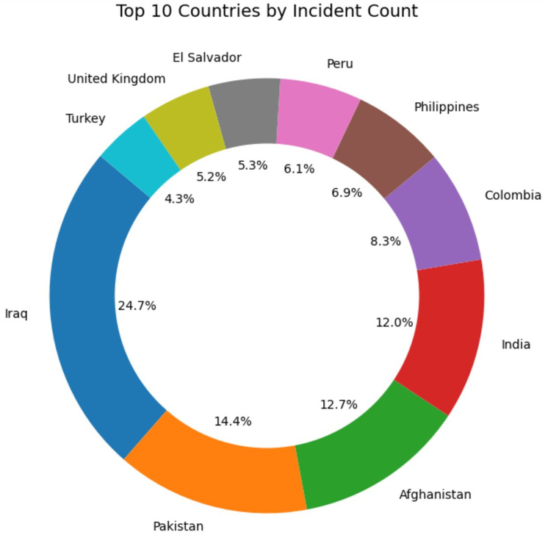
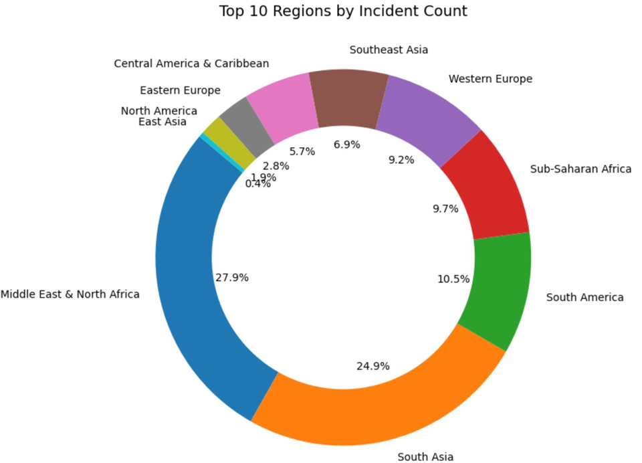
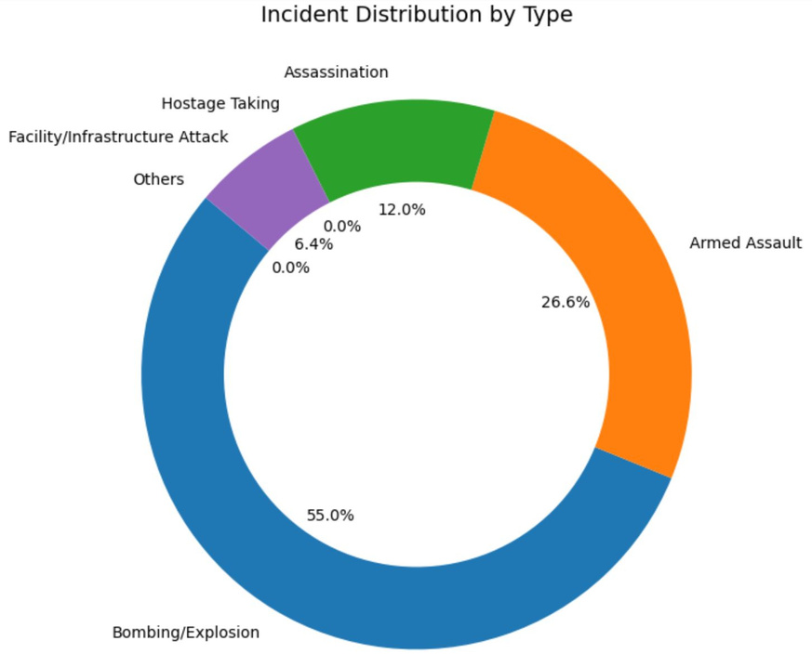

Data Collection and Exploration
CENG463 - Machine Learning

Slide 7
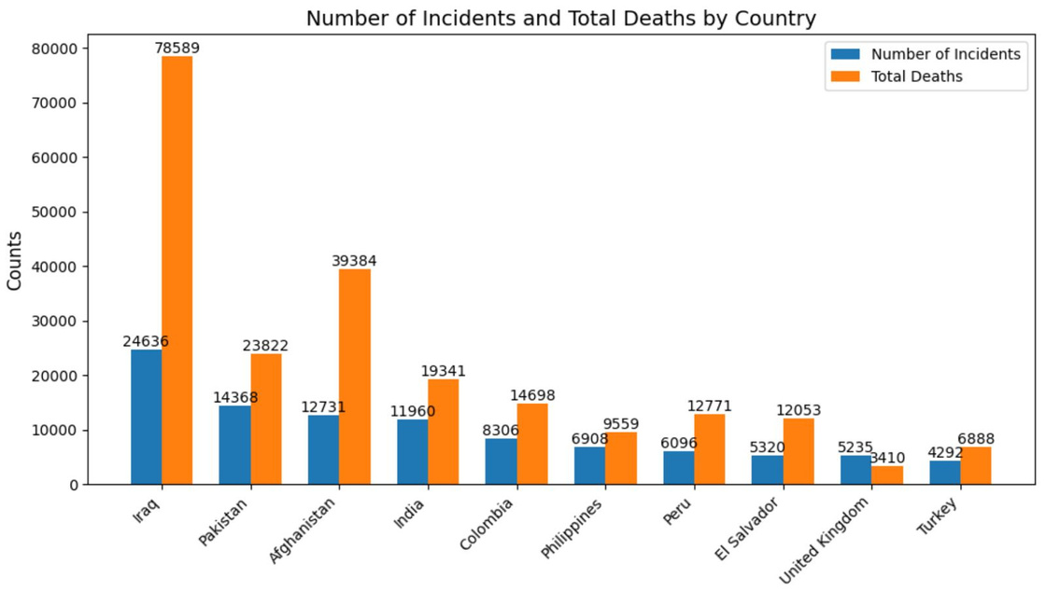
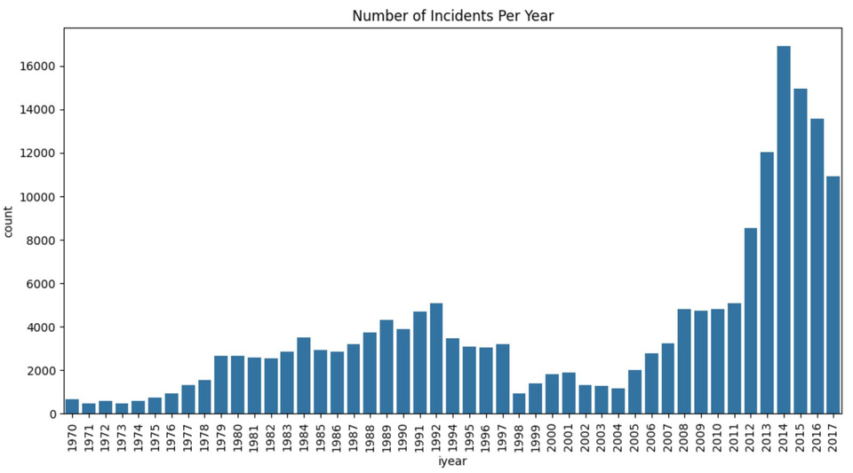
Data Collection and Exploration
CENG463 - Machine Learning

Slide 8

CENG463 - Machine Learning
Data Preprocessing
Data Cleaning | Feature Engineering
Dropping duplicates Dropping columns that contains mostly NaN values Removes rows that contains NaN values in critical columns | Matching the success criteria Encoding categorical features Scaling numerical features

Slide 9


Algorithms
CENG463 - Machine Learning
 | Prediction Model | Classification Model
Logistic Regression
Support Vector Machines (SVM)
Bernoulli Naive Bayes
K Nearest Neighbors (kNN)

Slide 10
CENG463 - Machine Learning
Logistic regression is inherently designed for prediction tasks, which aligns well with the problem of predicting whether a terrorism incident will succeed (1) or fail (0).
If the features and target variable have a roughly linear relationship in log-odds, logistic regression is an ideal choice as it efficiently models this relationship.
Logistic regression is computationally efficient.
Logistic regression can handle imbalanced datasets effectively, ensuring balanced predictions as reflected in the confusion matrix.
Logistic regression is often used as a strong baseline model to evaluate the feasibility of more complex models. Given its solid performance here, it may be sufficient without requiring more complex approaches.,
Motivation
Logistic Regression in Prediction

Slide 11

CENG463 - Machine Learning
Motivation
Classification
Logistic Regression | Key Characteristics: Logistic regression is simple, interpretable, and computationally efficient, performing well with a linear relationship between features and the log-odds of the target variable. Interpretability: Enables straightforward understanding of feature contributions, making it ideal for transparent predictions.
Support Vector Machines (SVM) | Strengths of SVMs: Particularly effective in high-dimensional spaces and for well-separated classes, SVMs excel in complex classification tasks by maximizing the margin between classes. Versatility: Handles both linear and non-linear relationships, making it adaptable to diverse datasets.

Slide 12
CENG463 - Machine Learning
Motivation
Classification
Bernoulli Naive Bayes | Effective for Binary/Categorical Features: Bernoulli Naive Bayes excels with binary or categorical data, assuming independent impacts of feature presence or absence on classification. Use Cases: Ideal for rapid prototyping and scenarios prioritizing interpretability and speed.
K Nearest Neighbors (kNN) | Algorithm Characteristics: kNN is a non-parametric, instance-based algorithm that predicts based on the similarity of data points to their nearest neighbors. Strengths and Requirements: Intuitive and flexible, kNN benefits from proper feature scaling and optimal parameter tuning (e.g., selecting the best k).

Slide 13

Data Preprocessing
CENG463 - Machine Learning
Removed duplicates and missing values.
Excluded rows with unknown attack types, months, or days.
Encoded categorical variables and scaled numerical variables
Experimental Scheme
Model Training and Evaluation
Split dataset into 80% training and 20% testing sets.
Evaluation metrics include:
Accuracy, precision, recall, f1-score
Confusion Matrix to analyze true/false positives and negatives.

Slide 14

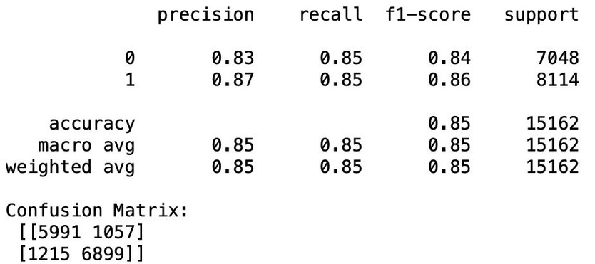
CENG463 - Machine Learning
Accuracy
The model achieved an accuracy of 85%, indicating a good overall performance in classification tasks.
Results
Missclassifications
The confusion matrix reveals that 1,218 samples from Class 1 were incorrectly predicted, and 1,059 samples from Class 0 were incorrectly.
Logistic Regression for Prediction

Slide 15
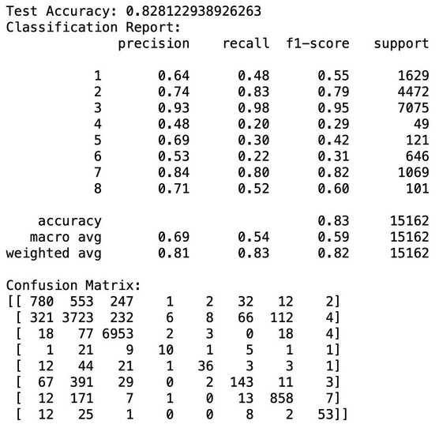
CENG463 - Machine Learning
Accuracy
The model achieved an accuracy of 82.8%, indicating strong overall performance.
Results
Missclassifications
Misclassifications are more frequent for minority classes, showing room for improvement in handling class imbalance
Logistic Regression for Classification

Slide 16
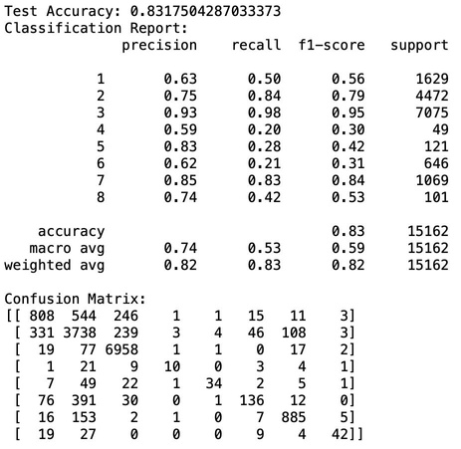
CENG463 - Machine Learning
Accuracy
SVM achieved a slightly higher accuracy (83.2%) compared to Logistic Regression.
Results
Confusion Matrix
The confusion matrix indicates fewer false negatives for majority classes, which contributes to the higher recall values overall.
SVM for Classification

Slide 17
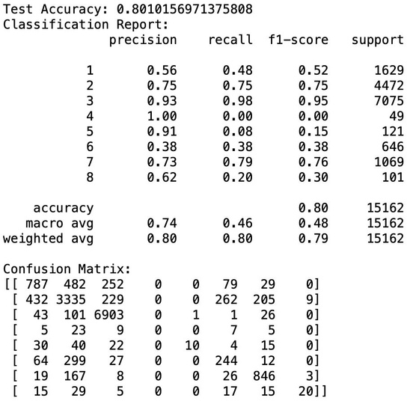
CENG463 - Machine Learning
Accuracy
The accuracy of 80.0% is lower than that of Logistic Regression and SVM, suggesting BNB is less effective on this dataset.
Results
Missclassification
A high number of misclassifications are observed for Classes 4 and 5, reinforcing the interpretation of poor minority class performance.
Bernoulli Naive Bayes for Classification

Slide 18
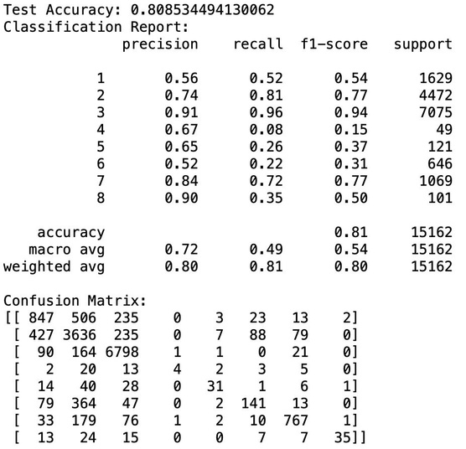
CENG463 - Machine Learning
Accuracy
The model achieved an accuracy of 80.8%, slightly better than BNB but lower than Logistic Regression and SVM.
Results
Missclassification
Errors are more dispersed across minority classes, indicating challenges in maintaining class balance during predictions.
kNN for Classification

Slide 19
CENG463 - Machine Learning
Trends and Patterns
Prediction | Balanced Performance: The model demonstrates consistent performance across classes, with similar precision, recall, and F1-scores for Classes 0 and 1, indicating no significant class bias. Temporal Trends: A sharp rise in incidents post-2000, peaking in recent years, highlights the importance of focusing on high-frequency periods for improving predictive accuracy.
Classification | Performance on Majority vs. Minority Classes: Majority class (3, Bombing) consistently achieves high precision, recall, and F1-scores across all models, while minority classes (e.g., 4, 5, 8) show significant performance decline, especially with BNB and kNN. Model Comparison: SVM slightly outperforms Logistic Regression in accuracy and F1-scores for key classes, emerging as the best overall model, while BNB shows the lowest accuracy and poorest performance, making it unsuitable for the dataset. Balanced Performance: Logistic Regression effectively balances performance across classes compared to kNN and BNB, maintaining high accuracy.

Slide 20

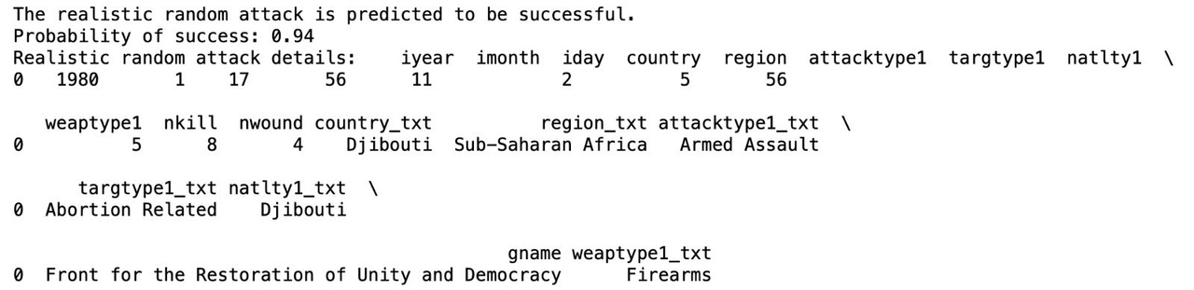



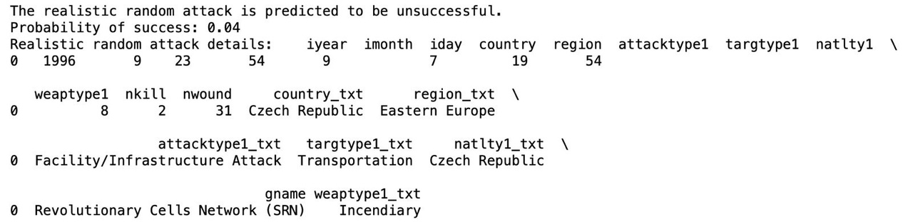


CENG463 - Machine Learning
Future Predictions
Using the most recent year's data distribution, the model simulated potential attack outcomes

Slide 21
CENG463 - Machine Learning
Improvements
Challenges Identified | Proposed Enhancements
Data imbalance for certain attack types (e.g., rare categories like hijackings). Limited feature set, as political or economic factors were not included. | Incorporate external datasets with socioeconomic and geopolitical indicators. Experiment with ensemble methods like XGBoost to improve accuracy. Develop a feature selection process to identify the most predictive features.

Slide 22







CENG463 - Machine Learning
Conclusion
Successfully predicted and classified terrorism incidents using machine learning.
Highlighted the importance of data-driven insights for global security and policymaking.
Future improvements can expand the model's applicability and accuracy.

